Slide 1
European steel markets amid changing global trade scenarios
A McCloskey by OPIS webinar
May 2025
Alessandro Sciamarelli, Director, Market Analysis and Economic Studies, EUROFER
Maria Tanatar, Associate Director, Global Steel & Business Development, McCloskey by OPIS
Ranjana von Wendland, Associate Director, Steel Raw Materials Business Development, McCloskey by OPIS
Dr. James Stevenson, Vice President & Research Lead, McCloskey by OPIS

Slide 2
Critical drivers of global steel in the short to medium term
Trump Administration
Massive uncertainty
China
India
Long term growth, but weak near-term economics are a challenge
CBAM
Feedstock scarcity
A push to delay? What will happen?
A strong project pipeline for green steel in Europe, the Middle East, and the Far East
Is green moving down the agenda?
But the process will be episodic – with gas DRI likely a beneficiary until hydrogen and CCUS deployment can accelerate
Tariffs a key agenda item
No imminent signs of a recovery in Chinese steel production, and it will be masked by an ongoing long-term decline. Will 50mt production cut be implemented?
US and global industrial recession?
And ongoing Chinese decline will be offset by growth elsewhere – lead by Chinese entities – China “friendshoring”
Most steel feedstocks look likely to be tight in the 2030s. This is a huge issue and will drive high steel prices.
Is green steel coming?
Growth of the Middle East as a green steel/feedstock hub

Slide 3
Demand and price outlook

Slide 4
Q&A

Slide 5
Hot-rolled coil prices

Slide 6
Global steel trade protectionism
Major trade measures in the US, 2025
Feb 1 | 10% tariffs on goods from China; 25% - Mexico, 25% on most goods from Canada, and 10% on oil, gas, and potash.
Mar 12 | Section 232 25% tariffs on all steel, aluminium imports reset
Mar 26 | 25% automotive tariffs
Apr 2 | "Liberation Day" tariffs
Major trade measures in the EU, 2025
Mar 26 | Safeguard measures review finalized
Apr 7 | Preliminary duties of 6.9-31.8% on HRC imports from Egypt, Japan and Vietnam
 | CBAM payment delayed until 2027

Slide 7
European green steel market overview
European green steel market
Activity in the green steel market follows traditional steel market
Distributors became more involved in green steel trading
Lack of standards slows down the market
Mills’ approach to trading differs
Availability remains limited
Construction and infrastructure projects have started to calculate embedded CO2 and book steel and other products to meet the targets
Automotive manufacturers set internal CO2 emission targets using price of reduced carbon approach

Slide 8
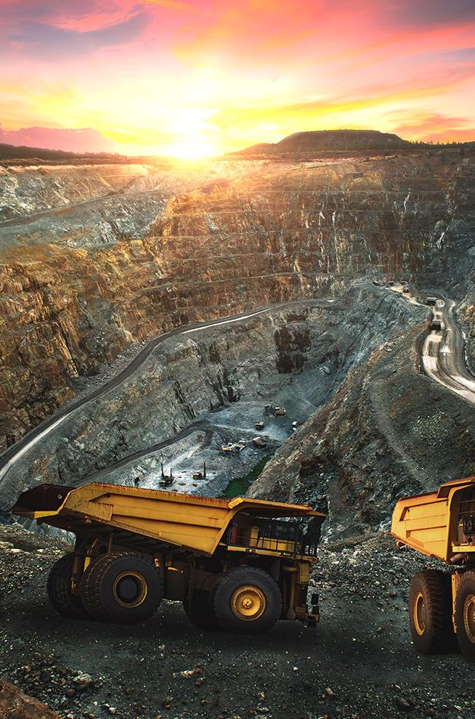
Coal, Metals & Mining Pricing, Analysis & News
Strengthen your company position and better plan growth strategies in the global economy with coal, metals and mining data from McCloskey by OPIS
Robust price discovery
Independent reporting of market news
Insightful and reliable analysis
Advisory support from our industry experts
These services help you to understand how supply and demand are evolving, by quality and end-use sector, enhancing your trading, procurement, and selling strategies.
  Key Products:
  Energy Markets & Research
  Steel Raw Materials Markets & Research
  North America Markets
  Greater China Markets
  APAC and Africa Markets
  MineSpans: Metallurgical Coal
  Coal Value-Chain Emissions Database

